Slide 1
Distinguish an Inference from a Guess
Distinguish an Inference from a Guess · Learner copy In this 45-minute lesson, learners distinguish a directly stated detail, an inference supported by text, and an unsupported guess; explain how a detail supports an inference; and compare two defensible possibilities while naming what the text does not establish.

Slide 2
Detail, inference, or unsupported guess?
Detail: something the passage states directly. You can point to the words that say it. Inference: a reasonable idea the passage does not state word-for-word. Support it with an accurate, relevant detail and explain the connection. A detail can make an inference reasonable without proving it. Unsupported guess: a possible idea for which the passage gives no accurate, relevant support. A guess may turn out to be true, but this passage does not give readers a reason to choose it. Two readers may offer different inferences when each one fits the text. Check: What does the passage say? What might that suggest? How does the detail connect to the idea? What remains uncertain?

Slide 3
Model: Remy's poster
Invented instructional example. Before the school art show, Remy carried a poster to the display wall. One corner curled away from the tape. Remy pressed two fresh strips over the corner and stepped back to the doorway. Remy tilted their head, then looked once more at the corner.

Slide 4
Talk through the model
Read “Remy checks the poster.” Identify one detail the passage states directly. What might Remy be checking? Give one inference, point to a detail, and explain the connection. Name a second possible inference that also fits, one unsupported guess, and one thing the passage does not establish. Then compare your thinking with the model.

Slide 5
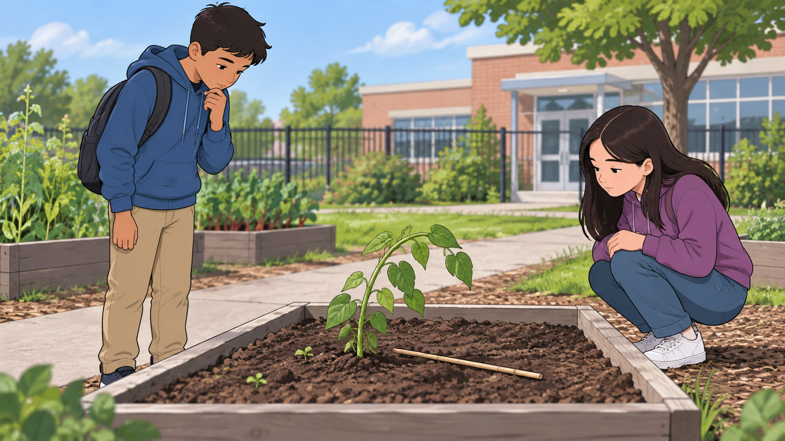
Look at the garden scene
Original generated illustration for this lesson. The picture sets the scene; use the story text, not picture details, as evidence for the inference task.

Slide 6
Read: The leaning bean plant
Invented instructional example. After recess, Mina and Theo stopped beside a bean plant in the school garden. From the path, Mina noticed one stem leaning toward the edge of its wooden raised bed. A green twist tie still looped around the stem. Theo crouched across the bed and spotted a thin wooden support stick lying on the soil, its pointed end near the rim. A few leaves rested on the soil. A garden log said the table next to the bed had been moved so it could be cleaned after lunch. Mina said, “Maybe the plant needs a new support.” Theo said, “Maybe the plant was bumped when the table moved.” They left the plant in place and asked their teacher to look with them.

Slide 7
Guided practice: compare possibilities
With a partner, use “The leaning bean plant.” First, underline two details that the passage states directly. Classify “one stem is leaning” as a detail, “the plant may need new support” as an inference, and “someone broke it on purpose” as a guess unless you find support in the text. Then compare Mina’s and Theo’s ideas. What detail supports each one? Explain why both may be possible and name one thing the passage does not establish. Use the passage, not the slide illustration, as evidence.

Slide 8
Independent passage: Color choices
Invented instructional example. At art club, Jalen set two color swatches beside an unfinished mural sketch. A note on the table said, “Compare colors by the window.” Jalen moved the sketch toward the window, held a green swatch beside one section, then tried a blue swatch in the same place. Jalen kept both swatches beside the sketch and wrote “Ask the group” on a sticky note. The mural was still unfinished.

Slide 9
Independent response
Read “Color choices” on your own. Write 4–5 sentences. State one inference about what Jalen may be deciding or checking. Use two accurate details and explain how they support it. Give a different possible inference and its supporting detail. Then classify the claim “Jalen plans to remove every green part of the mural” as a detail, supported inference, or unsupported guess; explain what the passage does or does not support and name one thing you still cannot know. You may plan in the organizer on the next page. Use the passage only.

Slide 10
Plan your inference
Use the organizer on the learner page or on paper. Use this optional page to plan your independent response. Record only details and possibilities from “Color choices.” The organizer gives space; it does not choose the inference or evidence for you. Two details the passage states directly One inference I can support How the details support this inference A different possible inference and its detail Named claim: detail, supported inference, or unsupported guess? Why? What the passage still does not establish

